Slide 1
Large-Language Assisted Data Analysis Tool
Rijul Saini

Slide 2
What is LLADA?
LLADA is a Python package designed to facilitate the data analysis process by integrating large language models (LLMs) via the OpenAI API. This package allows users to summarize datasets, generate data analysis goals, execute analysis, and interpret the results in natural language.
It comprises of 4 main modules:
Summarizer
Goal Generator
Analyzer
Interpreter
Generates JSON and text summaries of the input data frame.
Generates analysis suggestions (goals) for the data, along with some rationale for why the analysis is needed.
Generates and executes Python code for the analysis goals.
Generates natural language interpretation of the analysis results for the user.

Slide 3
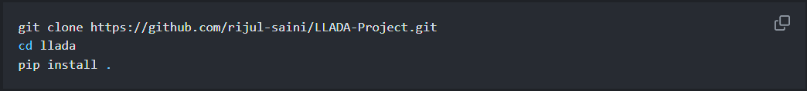
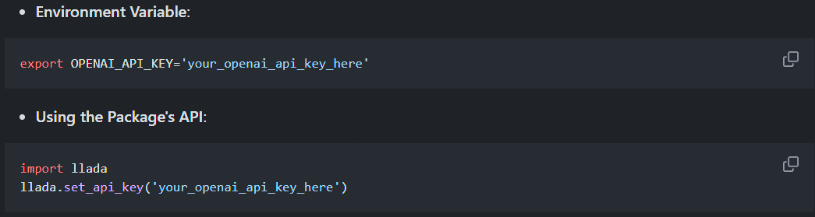
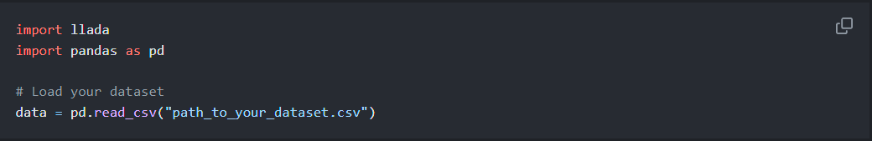
How to use?
LLADA is available for download as a python package at my GitHub page.
Installation:
Configuration:
Example usage:

Slide 4
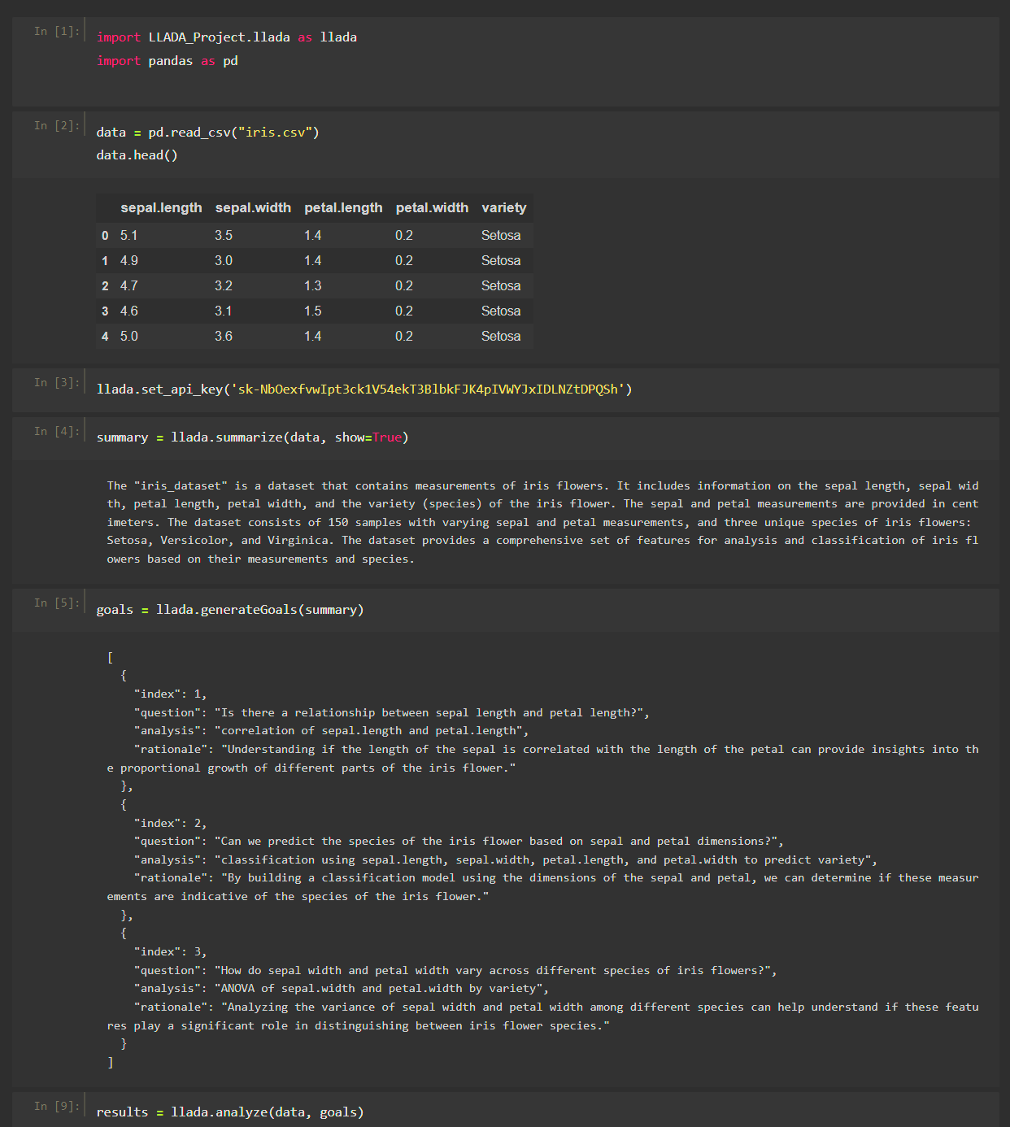
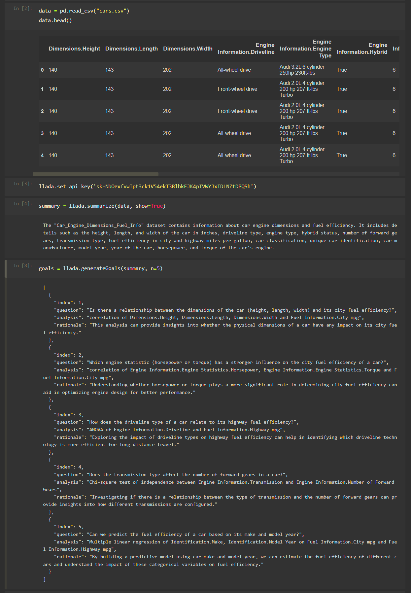
I. Summarizer
Generates a JSON summary of the dataset for the goal generation step.
Optionally, you can also print a natural language summary of the data by passing argument ‘show = True’ (Set to False by default).
In action:

Slide 5
II. Goal Generator
Generates analysis suggestions for the data, along with some rationale for why the analysis is needed.
Number of goals to be generated can be set by specifying the n argument (n = 3 by default).
The function returns a list of 'goals', where each 'goal' is a dictionary containing: index, question, analysis, and rationale.
In action:

Slide 6
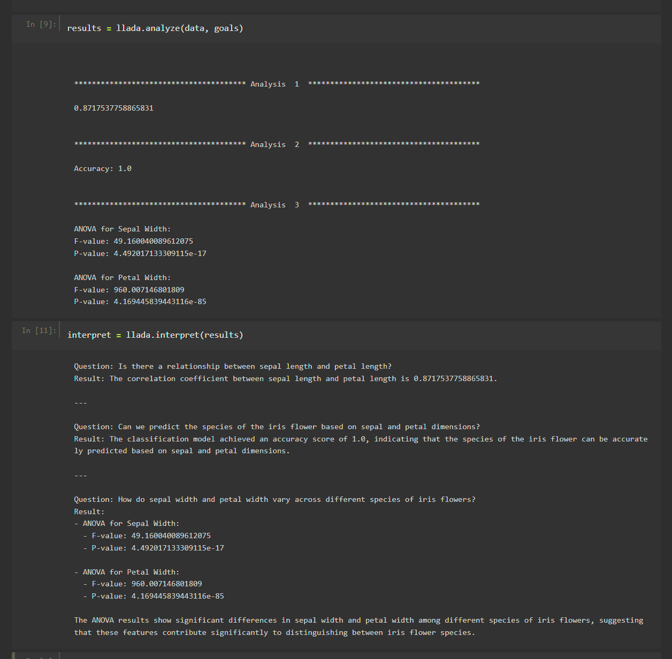
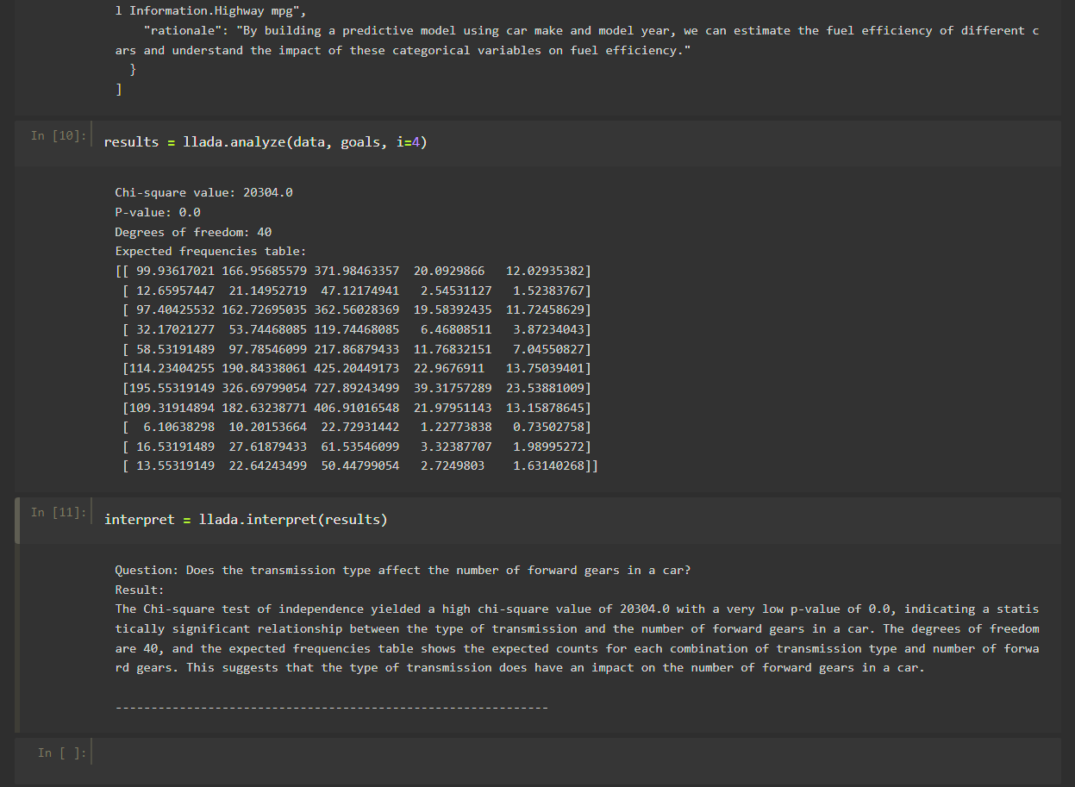
III. Analyzer
Generates and executes Python code for the analysis goals.
If multiple goals are passed as argument, all goals will be analyzed by default. Optionally, you can pass ‘I’ argument to specify any goal by index from goals, and only that analysis will be generated.
The generated analysis code's execution is output to the console, and the function returns a list of 'results' where each 'result' is a dictionary containing: index, question, analysis code, result, rationale.
In action:

Slide 7
IV. Interpreter
Generates natural language interpretation of the analysis results for the user.
The function returns and prints a string containing the questions and their results derived from the analyses.
In action:

Slide 8
Limitations and Future Work
Limited input scope: The project focuses primarily on structured datasets and may not fully address the needs of users working with unstructured or semi-structured data. Summarizer can be refined or improved to process semi or unstructured data.
Limited analysis scope: The tool struggles to successfully execute complex analyses like multiple regression or clustering. Further refinements to the code generation algorithm could allow for more robust analyses to be performed.
Performance constraints: The performance of the tool may be limited by computational resources, particularly when working with large datasets or complex analysis tasks. Explore strategies for improving the performance and scalability of the tool, such as parallel processing, prompt optimization, or even training LLMs on data specific to the project needs.
User interface: While the tool aims to be user-friendly, there may be opportunities to further improve the user interface and user experience to enhance usability and accessibility. Like adding front-end functionality for ease of use.

Slide 9
Thank you! Questions?

